Slide 1
Stable Matching
CS 330 Intro to the Design and Analysis of Algorithms
Lecture note
Dr. Sajedul Talukder

Slide 2
Historical context
National resident matching program (NRMP).
Centralized clearinghouse to match med-school students to hospitals.
Began in 1952 to fix unraveling of offer dates.
Originally used the “Boston Pool” algorithm.
Algorithm overhauled in 1998.
med-school student optimal
deals with various side constraints (e.g., allow couples to match together)
hospitals began making
offers earlier and earlier,
up to 2 years in advance
stable matching no longer guaranteed to exist
Notes:
“Boston Pool” algorithm to assign interns, so named because it had been previously used by a regional clearinghouse in the Boston area. Roth showed that Boston Pool algorithm is essentially the same as hospital-optimal version of Gale–Shapley (though a few minor differences).
The algorithm was first analyzed by David Gale and Lloyd Shapley, who proved that it produces a stable matching and that it is hospital optimal.
hospital may want to hire an extra resident in psychiatry if it is not assigned desired number of surgery residents
Resident = graduating medical student

Slide 3
Questbridge national college match
Low-income student. Ranks colleges.
College. Ranks students willing to admit (and limit).
Goal. Match students to colleges.

Slide 4
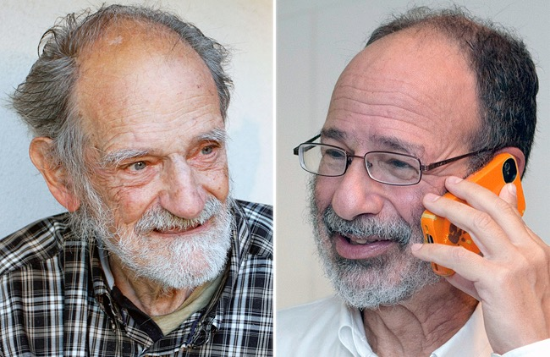
2012 Nobel Prize in Economics
Lloyd Shapley. Stable matching theory and Gale–Shapley algorithm.
Alvin Roth. Applied Gale–Shapley to matching med-school students with hospitals, students with schools, and organ donors with patients.
original applications: college admissions and
opposite-sex marriage
Lloyd Shapley
Alvin Roth
Notes:
Reference: New York Times, October 15, 2012.
Technically, the Sveriges Riksbank Prize in Economic Sciences in Memory of Alfred Nobel for 2012

Slide 5
Matching Residents to Hospitals
Goal: Given a set of preferences among hospitals and medical school students, design a
self-reinforcing admissions process.
Unstable pair: applicant x and hospital y are unstable if:
x prefers y to their assigned hospital.
y prefers x to one of its admitted students.
Stable assignment. Assignment with no unstable pairs.
Natural and desirable condition.
Individual self-interest will prevent any applicant/hospital deal from being made.

Slide 6
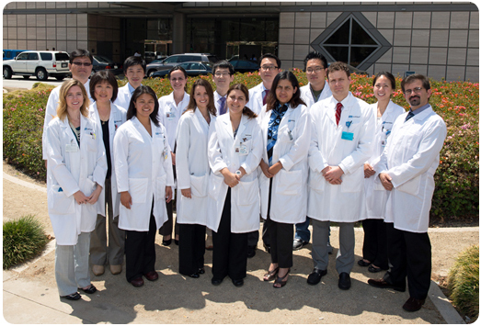
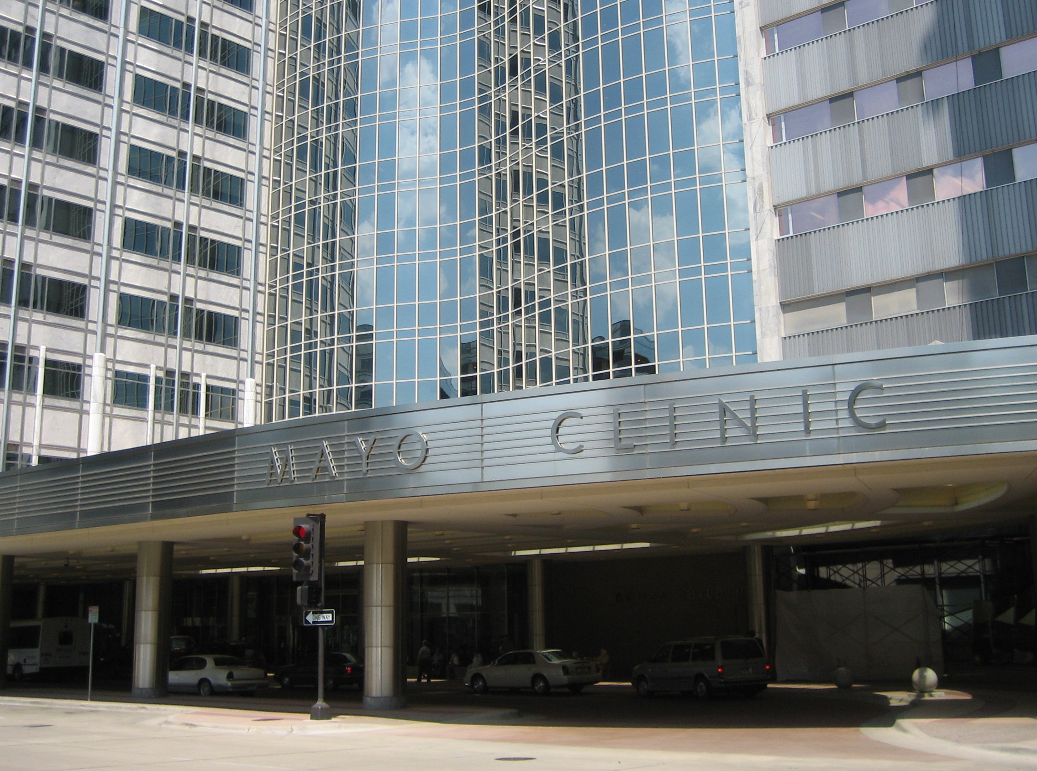
Matching med-school students to hospitals
Goal. Given a set of preferences among hospitals and med-school students, design a self-reinforcing admissions process.
Unstable pair. Hospital h and student s form an unstable pair if both:
h prefers s to one of its admitted students.
s prefers h to assigned hospital.
Stable assignment. Assignment with no unstable pairs.
Natural and desirable condition.
Individual self-interest prevents any hospital–student side deal.
Notes:
nice video of Canadian Match Program
http://www.carms.ca/the-match/how-it-works/

Slide 7
Stable Matching Problem
Goal. Given n men and n women, find a "suitable" matching.
Participants rate members of opposite sex.
Each man lists women in order of preference from best to worst.
Each woman lists men in order of preference from best to worst.
favorite
least favorite
favorite
least favorite
₁st
₂nd
₃rd
₁st
₂nd
₃rd
Xavier
Yuri Zoran
Amy
Brenda Amy
Brenda
Amy Brenda
Claire
Claire Claire
Amy
Brenda Claire
Yuri
Xavier Xavier
Xavier
Yuri Yuri
Zoran
Zoran Zoran
Men’s Preference Profile
Women’s Preference Profile

Slide 8
Stable Matching Problem
Perfect matching: everyone is matched monogamously.
Each man gets exactly one woman.
Each woman gets exactly one man.
Stability: no incentive for some pair of participants to undermine assignment by joint action.
In matching M, an unmatched pair m-w is unstable if man m and woman w prefer each other to current partners.
Unstable pair m-w could each improve by eloping.
Stable matching: perfect matching with no unstable pairs.
Stable matching problem. Given the preference lists of n men and n women, find a stable matching if one exists.

Slide 9
Stable Matching Problem
Q. Is assignment X-C, Y-B, Z-A stable?
favorite
least favorite
favorite
least favorite
 | ₁st | ₂nd | ₃rd |  |  | ₁st | ₂nd | ₃rd
Xavier | Amy | Brenda | Claire |  | Amy | Yuri | Xavier | Zoran
Yuri | Brenda | Amy | Claire |  | Brenda | Xavier | Yuri | Zoran
Zoran | Amy | Brenda | Claire |  | Claire | Xavier | Yuri | Zoran
Men’s Preference Profile
Women’s Preference Profile

Slide 10
Stable Matching Problem
Q. Is assignment X-C, Y-B, Z-A stable?
A. No. Brenda and Xavier will hook up.
favorite
least favorite
favorite
least favorite
 | ₁st | ₂nd | ₃rd |  |  | ₁st | ₂nd | ₃rd
Xavier | Amy | Brenda | Claire |  | Amy | Yuri | Xavier | Zoran
Yuri | Brenda | Amy | Claire |  | Brenda | Xavier | Yuri | Zoran
Zoran | Amy | Brenda | Claire |  | Claire | Xavier | Yuri | Zoran
Men’s Preference Profile
Women’s Preference Profile

Slide 11
Stable Matching Problem
Q. Is assignment X-A, Y-B, Z-C stable?
A. Yes.
favorite
least favorite
favorite
least favorite
 | ₁st | ₂nd | ₃rd |  |  | ₁st | ₂nd | ₃rd
Xavier | Amy | Brenda | Claire |  | Amy | Yuri | Xavier | Zoran
Yuri | Brenda | Amy | Claire |  | Brenda | Xavier | Yuri | Zoran
Zoran | Amy | Brenda | Claire |  | Claire | Xavier | Yuri | Zoran
Men’s Preference Profile
Women’s Preference Profile

Slide 12
Gale-Shapley Algorithm
Propose-and-reject algorithm. [Gale-Shapley 1962] Intuitive method that guarantees to find a stable matching.
Initialize each person to be free.
while (some man is free and hasn't proposed to every woman) {
Choose such a man m
w = 1st woman on m's list to whom m has not yet proposed if (w is free)
assign m and w to be engaged
else if (w prefers m to her fiancé m')
assign m and w to be engaged, and m' to be free else
w rejects m
}

Slide 13
Gale–Shapley demo
hospitals’ preference lists
 | 1st | 2nd | 3rd | 4th | 5th
Atlanta | Wayne | Val | Yolanda | Zeus | Xavier
Boston | Yolanda | Wayne | Val | Xavier | Zeus
Chicago | Wayne | Zeus | Xavier | Yolanda | Val
Detroit | Val | Yolanda | Xavier | Wayne | Zeus
El Paso | Wayne | Yolanda | Val | Zeus | Xavier
students’ preference lists
 | 1st | 2nd | 3rd | 4th | 5th
Val | El Paso | Atlanta | Boston | Detroit | Chicago
Wayne | Chicago | Boston | Detroit | Atlanta | El Paso
Xavier | Boston | Chicago | Detroit | El Paso | Atlanta
Yolanda | Atlanta | El Paso | Detroit | Chicago | Boston
Zeus | Detroit | Boston | El Paso | Chicago | Atlanta
Notes:
“proposes offer”
“rejects offer”
“accepts offer”

Slide 14
Gale–Shapley demo
hospitals’ preference lists
 | 1st | 2nd | 3rd | 4th | 5th
Atlanta | Wayne | Val | Yolanda | Zeus | Xavier
Boston | Yolanda | Wayne | Val | Xavier | Zeus
Chicago | Wayne | Zeus | Xavier | Yolanda | Val
Detroit | Val | Yolanda | Xavier | Wayne | Zeus
El Paso | Wayne | Yolanda | Val | Zeus | Xavier
Atlanta proposes to Wayne
students’ preference lists
 | 1st | 2nd | 3rd | 4th | 5th
Val | El Paso | Atlanta | Boston | Detroit | Chicago
Wayne | Chicago | Boston | Detroit | Atlanta | El Paso
Xavier | Boston | Chicago | Detroit | El Paso | Atlanta
Yolanda | Atlanta | El Paso | Detroit | Chicago | Boston
Zeus | Detroit | Boston | El Paso | Chicago | Atlanta

Slide 15
Gale–Shapley demo
hospitals’ preference lists
 | 1st | 2nd | 3rd | 4th | 5th
Atlanta | Wayne | Val | Yolanda | Zeus | Xavier
Boston | Yolanda | Wayne | Val | Xavier | Zeus
Chicago | Wayne | Zeus | Xavier | Yolanda | Val
Detroit | Val | Yolanda | Xavier | Wayne | Zeus
El Paso | Wayne | Yolanda | Val | Zeus | Xavier
Atlanta proposes to Wayne
Wayne accepts (since previously unmatched)
students’ preference lists
 | 1st | 2nd | 3rd | 4th | 5th
Val | El Paso | Atlanta | Boston | Detroit | Chicago
Wayne | Chicago | Boston | Detroit | Atlanta | El Paso
Xavier | Boston | Chicago | Detroit | El Paso | Atlanta
Yolanda | Atlanta | El Paso | Detroit | Chicago | Boston
Zeus | Detroit | Boston | El Paso | Chicago | Atlanta

Slide 16
Gale–Shapley demo
hospitals’ preference lists
 | 1st | 2nd | 3rd | 4th | 5th
Atlanta | Wayne | Val | Yolanda | Zeus | Xavier
Boston | Yolanda | Wayne | Val | Xavier | Zeus
Chicago | Wayne | Zeus | Xavier | Yolanda | Val
Detroit | Val | Yolanda | Xavier | Wayne | Zeus
El Paso | Wayne | Yolanda | Val | Zeus | Xavier
Boston proposes to Yolanda
students’ preference lists
 | 1st | 2nd | 3rd | 4th | 5th
Val | El Paso | Atlanta | Boston | Detroit | Chicago
Wayne | Chicago | Boston | Detroit | Atlanta | El Paso
Xavier | Boston | Chicago | Detroit | El Paso | Atlanta
Yolanda | Atlanta | El Paso | Detroit | Chicago | Boston
Zeus | Detroit | Boston | El Paso | Chicago | Atlanta

Slide 17
Gale–Shapley demo
hospitals’ preference lists
 | 1st | 2nd | 3rd | 4th | 5th
Atlanta | Wayne | Val | Yolanda | Zeus | Xavier
Boston | Yolanda | Wayne | Val | Xavier | Zeus
Chicago | Wayne | Zeus | Xavier | Yolanda | Val
Detroit | Val | Yolanda | Xavier | Wayne | Zeus
El Paso | Wayne | Yolanda | Val | Zeus | Xavier
Boston proposes to Yolanda
Yolanda accepts (since previously unmatched)
students’ preference lists
 | 1st | 2nd | 3rd | 4th | 5th
Val | El Paso | Atlanta | Boston | Detroit | Chicago
Wayne | Chicago | Boston | Detroit | Atlanta | El Paso
Xavier | Boston | Chicago | Detroit | El Paso | Atlanta
Yolanda | Atlanta | El Paso | Detroit | Chicago | Boston
Zeus | Detroit | Boston | El Paso | Chicago | Atlanta

Slide 18
Gale–Shapley demo
hospitals’ preference lists
 | 1st | 2nd | 3rd | 4th | 5th
Atlanta | Wayne | Val | Yolanda | Zeus | Xavier
Boston | Yolanda | Wayne | Val | Xavier | Zeus
Chicago | Wayne | Zeus | Xavier | Yolanda | Val
Detroit | Val | Yolanda | Xavier | Wayne | Zeus
El Paso | Wayne | Yolanda | Val | Zeus | Xavier
Chicago proposes to Wayne
students’ preference lists
 | 1st | 2nd | 3rd | 4th | 5th
Val | El Paso | Atlanta | Boston | Detroit | Chicago
Wayne | Chicago | Boston | Detroit | Atlanta | El Paso
Xavier | Boston | Chicago | Detroit | El Paso | Atlanta
Yolanda | Atlanta | El Paso | Detroit | Chicago | Boston
Zeus | Detroit | Boston | El Paso | Chicago | Atlanta

Slide 19
Gale–Shapley demo
hospitals’ preference lists
 | 1st | 2nd | 3rd | 4th | 5th
Atlanta | Wayne | Val | Yolanda | Zeus | Xavier
Boston | Yolanda | Wayne | Val | Xavier | Zeus
Chicago | Wayne | Zeus | Xavier | Yolanda | Val
Detroit | Val | Yolanda | Xavier | Wayne | Zeus
El Paso | Wayne | Yolanda | Val | Zeus | Xavier
Chicago proposes to Wayne
Wayne accepts (and renounces Atlanta)
students’ preference lists
 | 1st | 2nd | 3rd | 4th | 5th
Val | El Paso | Atlanta | Boston | Detroit | Chicago
Wayne | Chicago | Boston | Detroit | Atlanta | El Paso
Xavier | Boston | Chicago | Detroit | El Paso | Atlanta
Yolanda | Atlanta | El Paso | Detroit | Chicago | Boston
Zeus | Detroit | Boston | El Paso | Chicago | Atlanta

Slide 20
Gale–Shapley demo
hospitals’ preference lists
 | 1st | 2nd | 3rd | 4th | 5th
Atlanta | Wayne | Val | Yolanda | Zeus | Xavier
Boston | Yolanda | Wayne | Val | Xavier | Zeus
Chicago | Wayne | Zeus | Xavier | Yolanda | Val
Detroit | Val | Yolanda | Xavier | Wayne | Zeus
El Paso | Wayne | Yolanda | Val | Zeus | Xavier
Atlanta proposes to Val
students’ preference lists
 | 1st | 2nd | 3rd | 4th | 5th
Val | El Paso | Atlanta | Boston | Detroit | Chicago
Wayne | Chicago | Boston | Detroit | Atlanta | El Paso
Xavier | Boston | Chicago | Detroit | El Paso | Atlanta
Yolanda | Atlanta | El Paso | Detroit | Chicago | Boston
Zeus | Detroit | Boston | El Paso | Chicago | Atlanta

Slide 21
Gale–Shapley demo
hospitals’ preference lists
 | 1st | 2nd | 3rd | 4th | 5th
Atlanta | Wayne | Val | Yolanda | Zeus | Xavier
Boston | Yolanda | Wayne | Val | Xavier | Zeus
Chicago | Wayne | Zeus | Xavier | Yolanda | Val
Detroit | Val | Yolanda | Xavier | Wayne | Zeus
El Paso | Wayne | Yolanda | Val | Zeus | Xavier
Atlanta proposes to Val
Val accepts (since previously unmatched)
students’ preference lists
 | 1st | 2nd | 3rd | 4th | 5th
Val | El Paso | Atlanta | Boston | Detroit | Chicago
Wayne | Chicago | Boston | Detroit | Atlanta | El Paso
Xavier | Boston | Chicago | Detroit | El Paso | Atlanta
Yolanda | Atlanta | El Paso | Detroit | Chicago | Boston
Zeus | Detroit | Boston | El Paso | Chicago | Atlanta

Slide 22
Gale–Shapley demo
hospitals’ preference lists
 | 1st | 2nd | 3rd | 4th | 5th
Atlanta | Wayne | Val | Yolanda | Zeus | Xavier
Boston | Yolanda | Wayne | Val | Xavier | Zeus
Chicago | Wayne | Zeus | Xavier | Yolanda | Val
Detroit | Val | Yolanda | Xavier | Wayne | Zeus
El Paso | Wayne | Yolanda | Val | Zeus | Xavier
Detroit proposes to Val
students’ preference lists
 | 1st | 2nd | 3rd | 4th | 5th
Val | El Paso | Atlanta | Boston | Detroit | Chicago
Wayne | Chicago | Boston | Detroit | Atlanta | El Paso
Xavier | Boston | Chicago | Detroit | El Paso | Atlanta
Yolanda | Atlanta | El Paso | Detroit | Chicago | Boston
Zeus | Detroit | Boston | El Paso | Chicago | Atlanta

Slide 23
Gale–Shapley demo
hospitals’ preference lists
 | 1st | 2nd | 3rd | 4th | 5th
Atlanta | Wayne | Val | Yolanda | Zeus | Xavier
Boston | Yolanda | Wayne | Val | Xavier | Zeus
Chicago | Wayne | Zeus | Xavier | Yolanda | Val
Detroit | Val | Yolanda | Xavier | Wayne | Zeus
El Paso | Wayne | Yolanda | Val | Zeus | Xavier
Detroit proposes to Val
Val rejects (since she prefers Atlanta)
students’ preference lists
 | 1st | 2nd | 3rd | 4th | 5th
Val | El Paso | Atlanta | Boston | Detroit | Chicago
Wayne | Chicago | Boston | Detroit | Atlanta | El Paso
Xavier | Boston | Chicago | Detroit | El Paso | Atlanta
Yolanda | Atlanta | El Paso | Detroit | Chicago | Boston
Zeus | Detroit | Boston | El Paso | Chicago | Atlanta

Slide 24
Gale–Shapley demo
hospitals’ preference lists
 | 1st | 2nd | 3rd | 4th | 5th
Atlanta | Wayne | Val | Yolanda | Zeus | Xavier
Boston | Yolanda | Wayne | Val | Xavier | Zeus
Chicago | Wayne | Zeus | Xavier | Yolanda | Val
Detroit | Val | Yolanda | Xavier | Wayne | Zeus
El Paso | Wayne | Yolanda | Val | Zeus | Xavier
Detroit proposes to Yolanda
students’ preference lists
 | 1st | 2nd | 3rd | 4th | 5th
Val | El Paso | Atlanta | Boston | Detroit | Chicago
Wayne | Chicago | Boston | Detroit | Atlanta | El Paso
Xavier | Boston | Chicago | Detroit | El Paso | Atlanta
Yolanda | Atlanta | El Paso | Detroit | Chicago | Boston
Zeus | Detroit | Boston | El Paso | Chicago | Atlanta

Slide 25
Gale–Shapley demo
hospitals’ preference lists
 | 1st | 2nd | 3rd | 4th | 5th
Atlanta | Wayne | Val | Yolanda | Zeus | Xavier
Boston | Yolanda | Wayne | Val | Xavier | Zeus
Chicago | Wayne | Zeus | Xavier | Yolanda | Val
Detroit | Val | Yolanda | Xavier | Wayne | Zeus
El Paso | Wayne | Yolanda | Val | Zeus | Xavier
Detroit proposes to Yolanda
Yolanda accepts (and renounces Boston)
students’ preference lists
 | 1st | 2nd | 3rd | 4th | 5th
Val | El Paso | Atlanta | Boston | Detroit | Chicago
Wayne | Chicago | Boston | Detroit | Atlanta | El Paso
Xavier | Boston | Chicago | Detroit | El Paso | Atlanta
Yolanda | Atlanta | El Paso | Detroit | Chicago | Boston
Zeus | Detroit | Boston | El Paso | Chicago | Atlanta

Slide 26
Gale–Shapley demo
hospitals’ preference lists
 | 1st | 2nd | 3rd | 4th | 5th
Atlanta | Wayne | Val | Yolanda | Zeus | Xavier
Boston | Yolanda | Wayne | Val | Xavier | Zeus
Chicago | Wayne | Zeus | Xavier | Yolanda | Val
Detroit | Val | Yolanda | Xavier | Wayne | Zeus
El Paso | Wayne | Yolanda | Val | Zeus | Xavier
Boston proposes to Wayne
students’ preference lists
 | 1st | 2nd | 3rd | 4th | 5th
Val | El Paso | Atlanta | Boston | Detroit | Chicago
Wayne | Chicago | Boston | Detroit | Atlanta | El Paso
Xavier | Boston | Chicago | Detroit | El Paso | Atlanta
Yolanda | Atlanta | El Paso | Detroit | Chicago | Boston
Zeus | Detroit | Boston | El Paso | Chicago | Atlanta

Slide 27
Gale–Shapley demo
hospitals’ preference lists
 | 1st | 2nd | 3rd | 4th | 5th
Atlanta | Wayne | Val | Yolanda | Zeus | Xavier
Boston | Yolanda | Wayne | Val | Xavier | Zeus
Chicago | Wayne | Zeus | Xavier | Yolanda | Val
Detroit | Val | Yolanda | Xavier | Wayne | Zeus
El Paso | Wayne | Yolanda | Val | Zeus | Xavier
Boston proposes to Wayne
Wayne rejects (since he prefers Chicago)
students’ preference lists
 | 1st | 2nd | 3rd | 4th | 5th
Val | El Paso | Atlanta | Boston | Detroit | Chicago
Wayne | Chicago | Boston | Detroit | Atlanta | El Paso
Xavier | Boston | Chicago | Detroit | El Paso | Atlanta
Yolanda | Atlanta | El Paso | Detroit | Chicago | Boston
Zeus | Detroit | Boston | El Paso | Chicago | Atlanta

Slide 28
Gale–Shapley demo
hospitals’ preference lists
 | 1st | 2nd | 3rd | 4th | 5th
Atlanta | Wayne | Val | Yolanda | Zeus | Xavier
Boston | Yolanda | Wayne | Val | Xavier | Zeus
Chicago | Wayne | Zeus | Xavier | Yolanda | Val
Detroit | Val | Yolanda | Xavier | Wayne | Zeus
El Paso | Wayne | Yolanda | Val | Zeus | Xavier
Boston proposes to Val
students’ preference lists
 | 1st | 2nd | 3rd | 4th | 5th
Val | El Paso | Atlanta | Boston | Detroit | Chicago
Wayne | Chicago | Boston | Detroit | Atlanta | El Paso
Xavier | Boston | Chicago | Detroit | El Paso | Atlanta
Yolanda | Atlanta | El Paso | Detroit | Chicago | Boston
Zeus | Detroit | Boston | El Paso | Chicago | Atlanta

Slide 29
Gale–Shapley demo
hospitals’ preference lists
 | 1st | 2nd | 3rd | 4th | 5th
Atlanta | Wayne | Val | Yolanda | Zeus | Xavier
Boston | Yolanda | Wayne | Val | Xavier | Zeus
Chicago | Wayne | Zeus | Xavier | Yolanda | Val
Detroit | Val | Yolanda | Xavier | Wayne | Zeus
El Paso | Wayne | Yolanda | Val | Zeus | Xavier
Boston proposes to Val
Val rejects (since she prefers Atlanta)
students’ preference lists
 | 1st | 2nd | 3rd | 4th | 5th
Val | El Paso | Atlanta | Boston | Detroit | Chicago
Wayne | Chicago | Boston | Detroit | Atlanta | El Paso
Xavier | Boston | Chicago | Detroit | El Paso | Atlanta
Yolanda | Atlanta | El Paso | Detroit | Chicago | Boston
Zeus | Detroit | Boston | El Paso | Chicago | Atlanta

Slide 30
Gale–Shapley demo
hospitals’ preference lists
 | 1st | 2nd | 3rd | 4th | 5th
Atlanta | Wayne | Val | Yolanda | Zeus | Xavier
Boston | Yolanda | Wayne | Val | Xavier | Zeus
Chicago | Wayne | Zeus | Xavier | Yolanda | Val
Detroit | Val | Yolanda | Xavier | Wayne | Zeus
El Paso | Wayne | Yolanda | Val | Zeus | Xavier
Boston proposes to Xavier
students’ preference lists
 | 1st | 2nd | 3rd | 4th | 5th
Val | El Paso | Atlanta | Boston | Detroit | Chicago
Wayne | Chicago | Boston | Detroit | Atlanta | El Paso
Xavier | Boston | Chicago | Detroit | El Paso | Atlanta
Yolanda | Atlanta | El Paso | Detroit | Chicago | Boston
Zeus | Detroit | Boston | El Paso | Chicago | Atlanta

Slide 31
Gale–Shapley demo
hospitals’ preference lists
 | 1st | 2nd | 3rd | 4th | 5th
Atlanta | Wayne | Val | Yolanda | Zeus | Xavier
Boston | Yolanda | Wayne | Val | Xavier | Zeus
Chicago | Wayne | Zeus | Xavier | Yolanda | Val
Detroit | Val | Yolanda | Xavier | Wayne | Zeus
El Paso | Wayne | Yolanda | Val | Zeus | Xavier
Boston proposes to Xavier
Xavier accepts (since previously unmatched)
students’ preference lists
 | 1st | 2nd | 3rd | 4th | 5th
Val | El Paso | Atlanta | Boston | Detroit | Chicago
Wayne | Chicago | Boston | Detroit | Atlanta | El Paso
Xavier | Boston | Chicago | Detroit | El Paso | Atlanta
Yolanda | Atlanta | El Paso | Detroit | Chicago | Boston
Zeus | Detroit | Boston | El Paso | Chicago | Atlanta

Slide 32
Gale–Shapley demo
hospitals’ preference lists
 | 1st | 2nd | 3rd | 4th | 5th
Atlanta | Wayne | Val | Yolanda | Zeus | Xavier
Boston | Yolanda | Wayne | Val | Xavier | Zeus
Chicago | Wayne | Zeus | Xavier | Yolanda | Val
Detroit | Val | Yolanda | Xavier | Wayne | Zeus
El Paso | Wayne | Yolanda | Val | Zeus | Xavier
El Paso proposes to Wayne
students’ preference lists
 | 1st | 2nd | 3rd | 4th | 5th
Val | El Paso | Atlanta | Boston | Detroit | Chicago
Wayne | Chicago | Boston | Detroit | Atlanta | El Paso
Xavier | Boston | Chicago | Detroit | El Paso | Atlanta
Yolanda | Atlanta | El Paso | Detroit | Chicago | Boston
Zeus | Detroit | Boston | El Paso | Chicago | Atlanta

Slide 33
Gale–Shapley demo
hospitals’ preference lists
 | 1st | 2nd | 3rd | 4th | 5th
Atlanta | Wayne | Val | Yolanda | Zeus | Xavier
Boston | Yolanda | Wayne | Val | Xavier | Zeus
Chicago | Wayne | Zeus | Xavier | Yolanda | Val
Detroit | Val | Yolanda | Xavier | Wayne | Zeus
El Paso | Wayne | Yolanda | Val | Zeus | Xavier
El Paso proposes to Wayne
Wayne rejects (since he prefers Chicago)
students’ preference lists
 | 1st | 2nd | 3rd | 4th | 5th
Val | El Paso | Atlanta | Boston | Detroit | Chicago
Wayne | Chicago | Boston | Detroit | Atlanta | El Paso
Xavier | Boston | Chicago | Detroit | El Paso | Atlanta
Yolanda | Atlanta | El Paso | Detroit | Chicago | Boston
Zeus | Detroit | Boston | El Paso | Chicago | Atlanta

Slide 34
Gale–Shapley demo
hospitals’ preference lists
 | 1st | 2nd | 3rd | 4th | 5th
Atlanta | Wayne | Val | Yolanda | Zeus | Xavier
Boston | Yolanda | Wayne | Val | Xavier | Zeus
Chicago | Wayne | Zeus | Xavier | Yolanda | Val
Detroit | Val | Yolanda | Xavier | Wayne | Zeus
El Paso | Wayne | Yolanda | Val | Zeus | Xavier
El Paso proposes to Yolanda
students’ preference lists
 | 1st | 2nd | 3rd | 4th | 5th
Val | El Paso | Atlanta | Boston | Detroit | Chicago
Wayne | Chicago | Boston | Detroit | Atlanta | El Paso
Xavier | Boston | Chicago | Detroit | El Paso | Atlanta
Yolanda | Atlanta | El Paso | Detroit | Chicago | Boston
Zeus | Detroit | Boston | El Paso | Chicago | Atlanta

Slide 35
Gale–Shapley demo
hospitals’ preference lists
 | 1st | 2nd | 3rd | 4th | 5th
Atlanta | Wayne | Val | Yolanda | Zeus | Xavier
Boston | Yolanda | Wayne | Val | Xavier | Zeus
Chicago | Wayne | Zeus | Xavier | Yolanda | Val
Detroit | Val | Yolanda | Xavier | Wayne | Zeus
El Paso | Wayne | Yolanda | Val | Zeus | Xavier
El Paso proposes to Yolanda
Yolanda accepts (and renounces Detroit)
students’ preference lists
 | 1st | 2nd | 3rd | 4th | 5th
Val | El Paso | Atlanta | Boston | Detroit | Chicago
Wayne | Chicago | Boston | Detroit | Atlanta | El Paso
Xavier | Boston | Chicago | Detroit | El Paso | Atlanta
Yolanda | Atlanta | El Paso | Detroit | Chicago | Boston
Zeus | Detroit | Boston | El Paso | Chicago | Atlanta

Slide 36
Gale–Shapley demo
hospitals’ preference lists
 | 1st | 2nd | 3rd | 4th | 5th
Atlanta | Wayne | Val | Yolanda | Zeus | Xavier
Boston | Yolanda | Wayne | Val | Xavier | Zeus
Chicago | Wayne | Zeus | Xavier | Yolanda | Val
Detroit | Val | Yolanda | Xavier | Wayne | Zeus
El Paso | Wayne | Yolanda | Val | Zeus | Xavier
Detroit proposes to Xavier
students’ preference lists
 | 1st | 2nd | 3rd | 4th | 5th
Val | El Paso | Atlanta | Boston | Detroit | Chicago
Wayne | Chicago | Boston | Detroit | Atlanta | El Paso
Xavier | Boston | Chicago | Detroit | El Paso | Atlanta
Yolanda | Atlanta | El Paso | Detroit | Chicago | Boston
Zeus | Detroit | Boston | El Paso | Chicago | Atlanta

Slide 37
Gale–Shapley demo
hospitals’ preference lists
 | 1st | 2nd | 3rd | 4th | 5th
Atlanta | Wayne | Val | Yolanda | Zeus | Xavier
Boston | Yolanda | Wayne | Val | Xavier | Zeus
Chicago | Wayne | Zeus | Xavier | Yolanda | Val
Detroit | Val | Yolanda | Xavier | Wayne | Zeus
El Paso | Wayne | Yolanda | Val | Zeus | Xavier
Detroit proposes to Xavier
Xavier rejects (since he prefers Boston)
students’ preference lists
 | 1st | 2nd | 3rd | 4th | 5th
Val | El Paso | Atlanta | Boston | Detroit | Chicago
Wayne | Chicago | Boston | Detroit | Atlanta | El Paso
Xavier | Boston | Chicago | Detroit | El Paso | Atlanta
Yolanda | Atlanta | El Paso | Detroit | Chicago | Boston
Zeus | Detroit | Boston | El Paso | Chicago | Atlanta

Slide 38
Gale–Shapley demo
hospitals’ preference lists
 | 1st | 2nd | 3rd | 4th | 5th
Atlanta | Wayne | Val | Yolanda | Zeus | Xavier
Boston | Yolanda | Wayne | Val | Xavier | Zeus
Chicago | Wayne | Zeus | Xavier | Yolanda | Val
Detroit | Val | Yolanda | Xavier | Wayne | Zeus
El Paso | Wayne | Yolanda | Val | Zeus | Xavier
Detroit proposes to Wayne
students’ preference lists
 | 1st | 2nd | 3rd | 4th | 5th
Val | El Paso | Atlanta | Boston | Detroit | Chicago
Wayne | Chicago | Boston | Detroit | Atlanta | El Paso
Xavier | Boston | Chicago | Detroit | El Paso | Atlanta
Yolanda | Atlanta | El Paso | Detroit | Chicago | Boston
Zeus | Detroit | Boston | El Paso | Chicago | Atlanta

Slide 39
Gale–Shapley demo
hospitals’ preference lists
 | 1st | 2nd | 3rd | 4th | 5th
Atlanta | Wayne | Val | Yolanda | Zeus | Xavier
Boston | Yolanda | Wayne | Val | Xavier | Zeus
Chicago | Wayne | Zeus | Xavier | Yolanda | Val
Detroit | Val | Yolanda | Xavier | Wayne | Zeus
El Paso | Wayne | Yolanda | Val | Zeus | Xavier
Detroit proposes to Wayne
Wayne rejects (since he prefers Chicago)
students’ preference lists
 | 1st | 2nd | 3rd | 4th | 5th
Val | El Paso | Atlanta | Boston | Detroit | Chicago
Wayne | Chicago | Boston | Detroit | Atlanta | El Paso
Xavier | Boston | Chicago | Detroit | El Paso | Atlanta
Yolanda | Atlanta | El Paso | Detroit | Chicago | Boston
Zeus | Detroit | Boston | El Paso | Chicago | Atlanta

Slide 40
Gale–Shapley demo
hospitals’ preference lists
 | 1st | 2nd | 3rd | 4th | 5th
Atlanta | Wayne | Val | Yolanda | Zeus | Xavier
Boston | Yolanda | Wayne | Val | Xavier | Zeus
Chicago | Wayne | Zeus | Xavier | Yolanda | Val
Detroit | Val | Yolanda | Xavier | Wayne | Zeus
El Paso | Wayne | Yolanda | Val | Zeus | Xavier
Detroit proposes to Zeus
students’ preference lists
 | 1st | 2nd | 3rd | 4th | 5th
Val | El Paso | Atlanta | Boston | Detroit | Chicago
Wayne | Chicago | Boston | Detroit | Atlanta | El Paso
Xavier | Boston | Chicago | Detroit | El Paso | Atlanta
Yolanda | Atlanta | El Paso | Detroit | Chicago | Boston
Zeus | Detroit | Boston | El Paso | Chicago | Atlanta

Slide 41
Gale–Shapley demo
hospitals’ preference lists
 | 1st | 2nd | 3rd | 4th | 5th
Atlanta | Wayne | Val | Yolanda | Zeus | Xavier
Boston | Yolanda | Wayne | Val | Xavier | Zeus
Chicago | Wayne | Zeus | Xavier | Yolanda | Val
Detroit | Val | Yolanda | Xavier | Wayne | Zeus
El Paso | Wayne | Yolanda | Val | Zeus | Xavier
Detroit proposes to Zeus
Zeus accepts (since previously unmatched)
students’ preference lists
 | 1st | 2nd | 3rd | 4th | 5th
Val | El Paso | Atlanta | Boston | Detroit | Chicago
Wayne | Chicago | Boston | Detroit | Atlanta | El Paso
Xavier | Boston | Chicago | Detroit | El Paso | Atlanta
Yolanda | Atlanta | El Paso | Detroit | Chicago | Boston
Zeus | Detroit | Boston | El Paso | Chicago | Atlanta

Slide 42
Gale–Shapley demo
hospitals’ preference lists
 | 1st | 2nd | 3rd | 4th | 5th
Atlanta | Wayne | Val | Yolanda | Zeus | Xavier
Boston | Yolanda | Wayne | Val | Xavier | Zeus
Chicago | Wayne | Zeus | Xavier | Yolanda | Val
Detroit | Val | Yolanda | Xavier | Wayne | Zeus
El Paso | Wayne | Yolanda | Val | Zeus | Xavier
STOP (stable matching)
students’ preference lists
 | 1st | 2nd | 3rd | 4th | 5th
Val | El Paso | Atlanta | Boston | Detroit | Chicago
Wayne | Chicago | Boston | Detroit | Atlanta | El Paso
Xavier | Boston | Chicago | Detroit | El Paso | Atlanta
Yolanda | Atlanta | El Paso | Detroit | Chicago | Boston
Zeus | Detroit | Boston | El Paso | Chicago | Atlanta
Notes:
Note: another stable matching is V-E W-C X-B Y-A Z-D where every student gets their first choice.

Slide 43
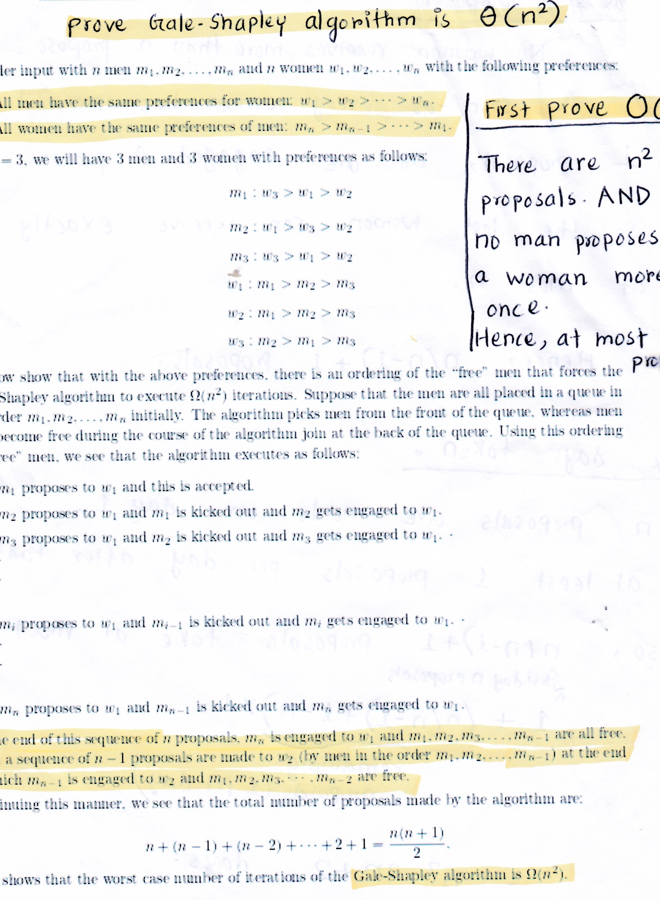
Time Complexity
Notes:
T(n) \; \le \;
\begin{cases}
\;0 & \text{ if $n = 1$ } \\[0.7em]
\;T(\lfloor n/2 \rfloor) \;+\; T(\lceil n/2 \rceil) \;+\; n & \text{ if $n > 1$ } \\
\end{cases}

Slide 44
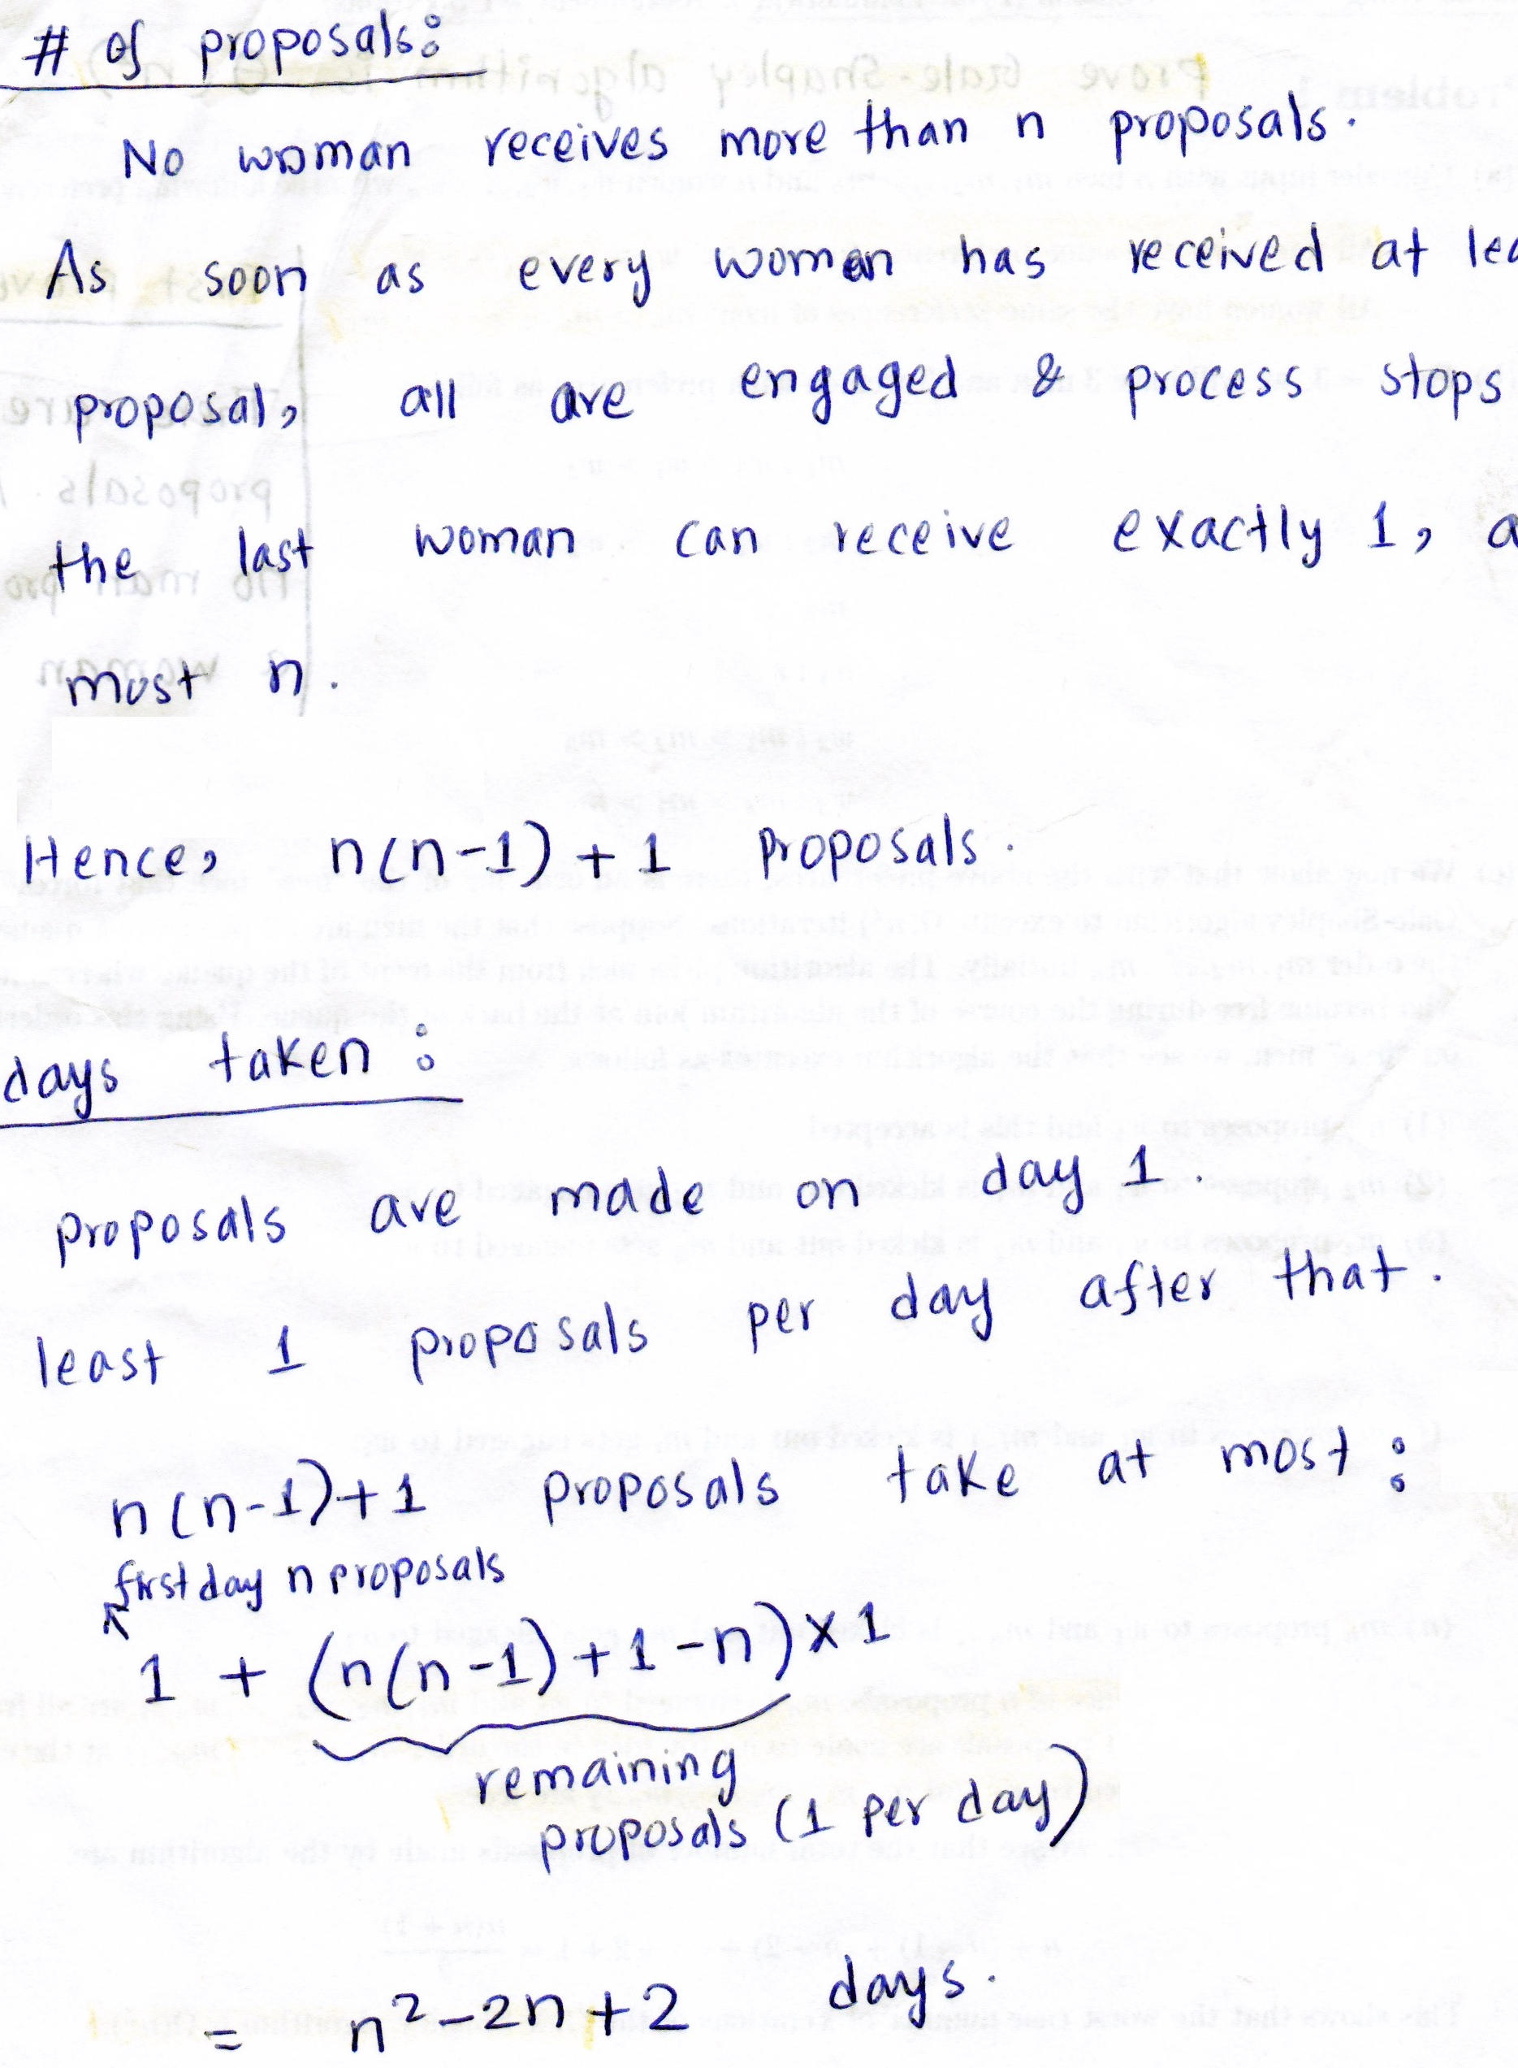
Other Analysis
Notes:
T(n) \; \le \;
\begin{cases}
\;0 & \text{ if $n = 1$ } \\[0.7em]
\;T(\lfloor n/2 \rfloor) \;+\; T(\lceil n/2 \rceil) \;+\; n & \text{ if $n > 1$ } \\
\end{cases}

